Slide 2


Multi-module support structures,
designed for easy assembling of photovoltaic panels
Efficiency
Dedicated design
Zonal adaptability
Low weight
Maximum solar incidence coefficient.
Resistance and durability
Structural resistance
Resistance to mechanical factors
Corrosion protection
Durability

Slide 3
Advantages of the TeraSteel galvanized profile structure
“Light construction" system - profiles with thin walls - obtained by cold profiling (does not structurally affect the constructive elements)
System customized to project/beneficiary requirements
Corrosion protection – passivation and hot-dip galvanizing – minimum Z275
Mechanical resistance – structural steel type S350 GD
Easy and quick assembly
Removable system
No additional maintenance costs
Increased accuracy of details
Reduced transport and assembly costs

Slide 4
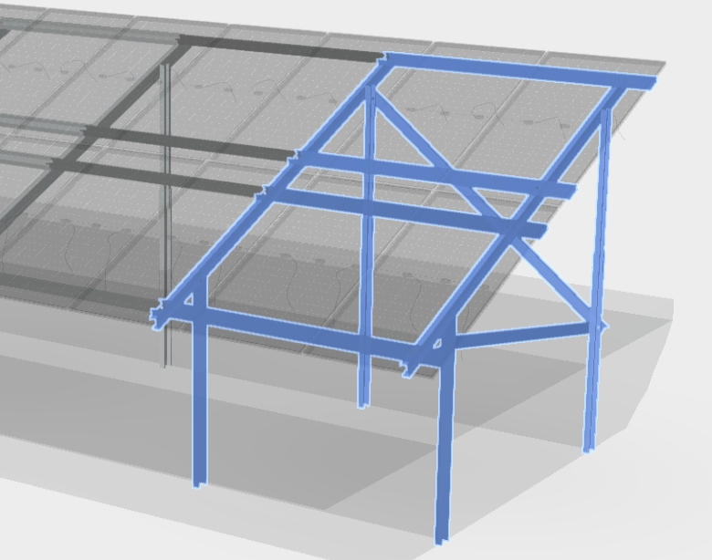
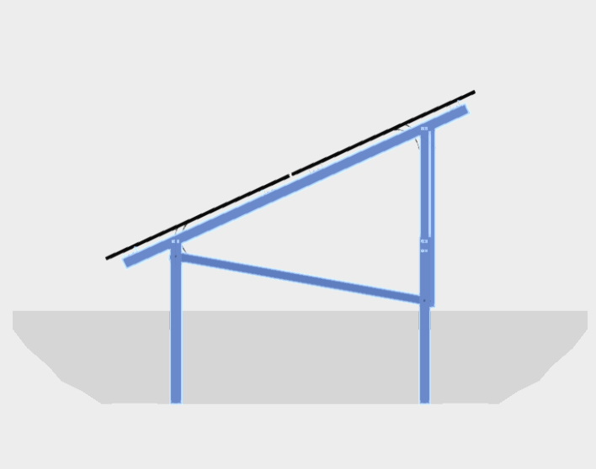
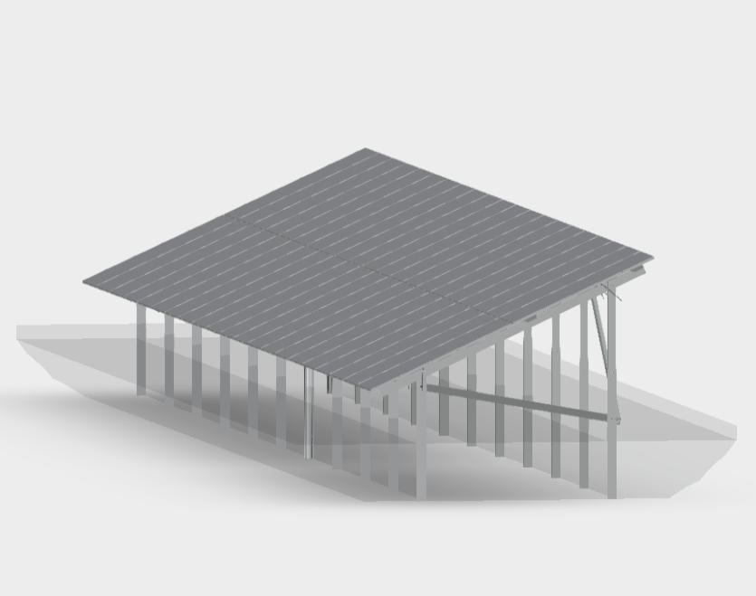
Assembly structure TeraSteel

Slide 5
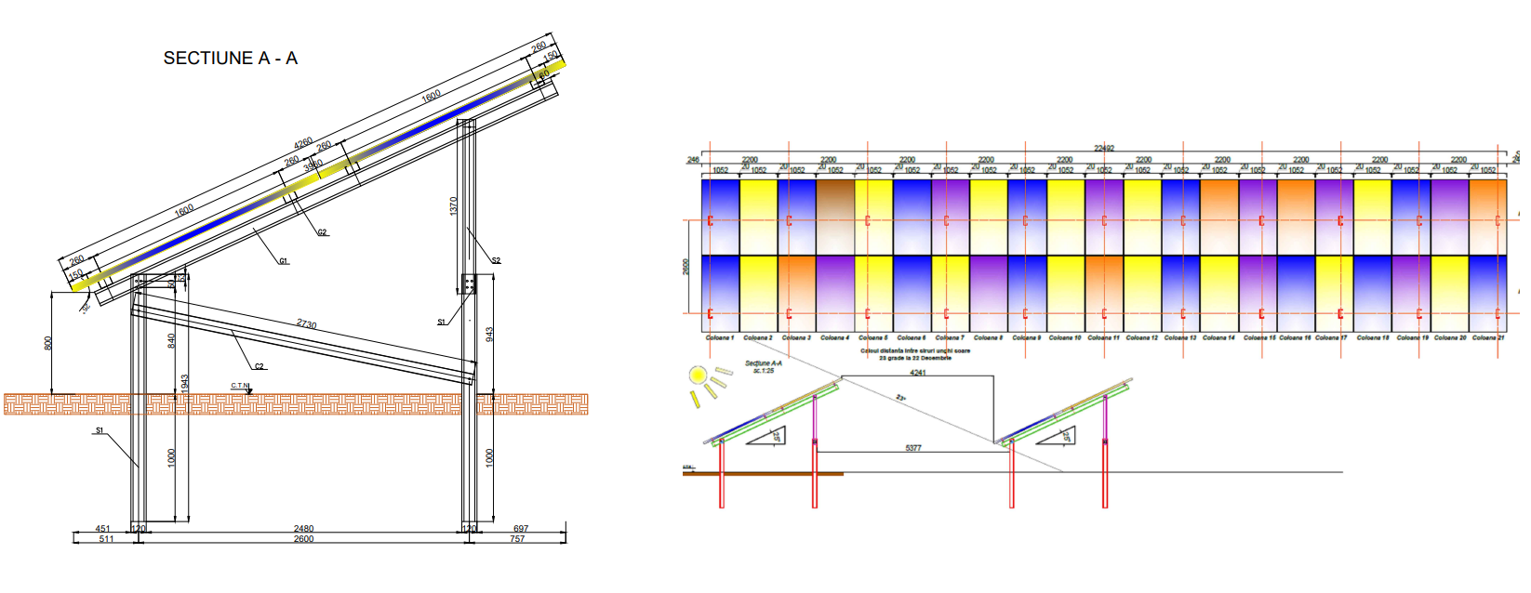
Case study
Photovoltaic park
Calculation for
support structure for 42 panels x 400 W = 16,8 KW

Slide 6
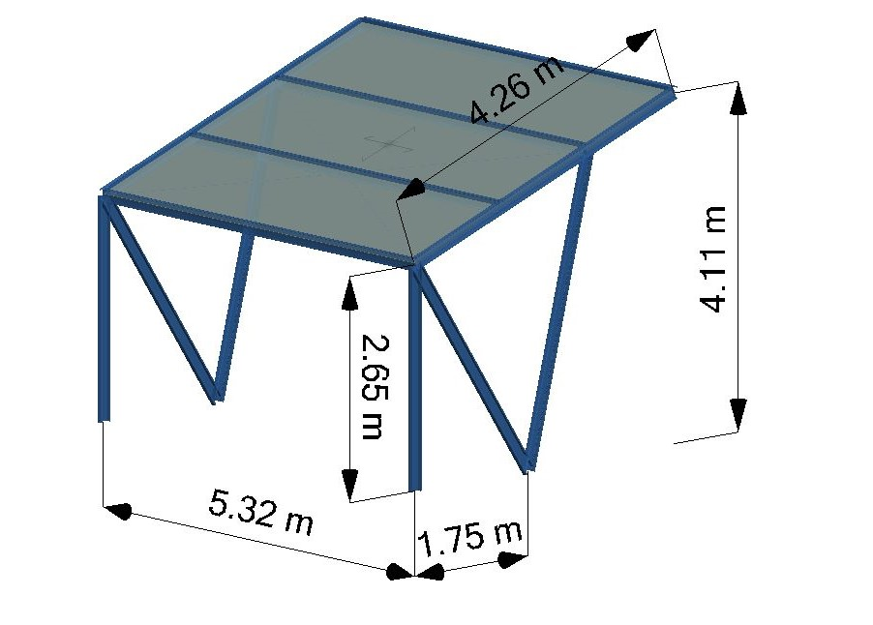
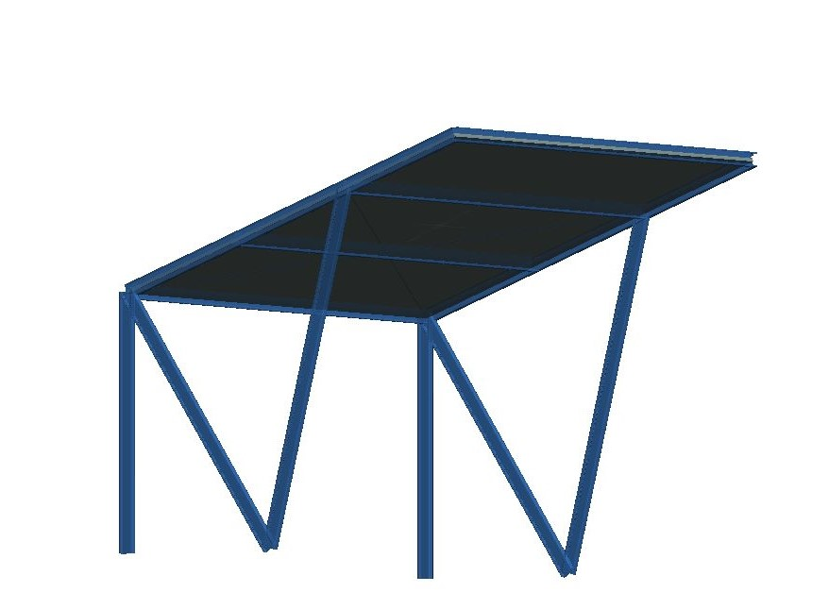
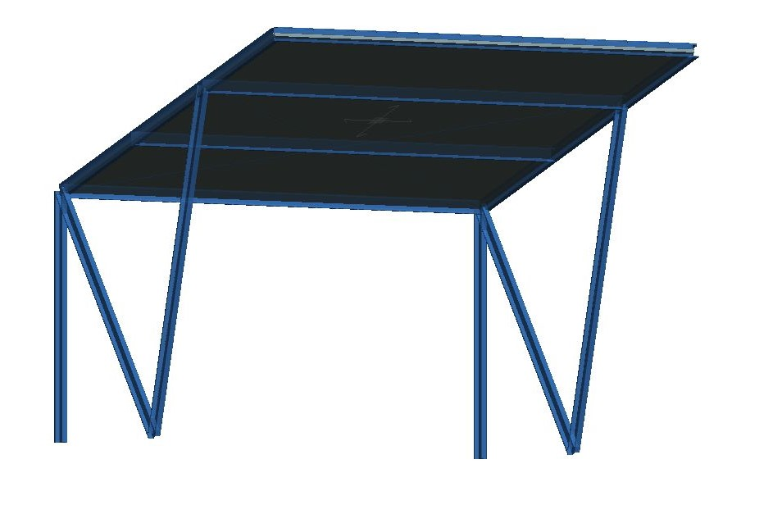
Case study
Photovoltaic parking lots
Calculation for
1 photovoltaic parking module-2 cars
10 panels x 400 W = 4 KW
Modules can adapt and multiply according to requirements.
Surplus energy can accumulate.
The resulting energy can be used to charge electric cars.

Slide 7
TeraSteel
Sat Sărăţel, comuna Șieu-Măgherus,
DN 15A, km 45+500
Bistriţa-Năsăud, ROMANIA
+40741 50 40 30 | office@terasteel.ro
Reproducerea, distribuția sau publicarea in orice formă a conținutului fară acordul companiei TeraSteel este strict interzisă.

